Slide 1
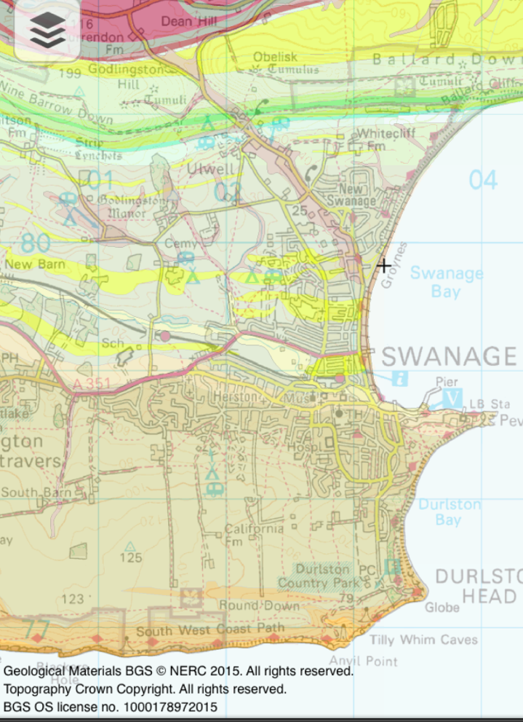
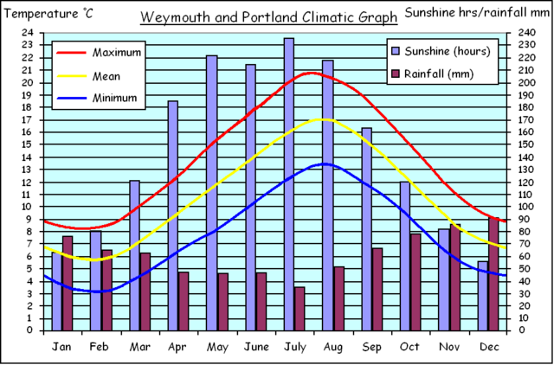
Swanage Secondary research summary.
Describe the Geology of the area
Explain why this has an impact on flooding
Identify the source of this information and assess it’s validity
When will evapotranspiration rates be highest?
What month is flooding most likely to occur based on this graph only?
When will most tourists be in Swanage?
Describe Swanage’s Climate
Assess the value of Met office data and identify the value of

Slide 2
To use these observations in an operational weather forecasting system we have to monitor their availability; quality control them, and process them into a form that can be used by the computer models and forecasters.
Surface data
Land-based synoptic
These cloud type and present weather and are usually sited at official weather stations. Surface pressure is usually reduced to a mean sea-level pressure. Many stations report pressure at the station altitude and some high-level stations compute a height at 850 hPa.
Marine
Surface data from ships and buoys. While temperature and moisture are measured at a height of 1-2 m over land, height may vary for marine data.
Wind
Wind data comes from measurements of ocean-backscatter observed from satellites. Wind data are taken at 10 m over land, but the height may vary for marine data.
Weather satellites
We continually investigate ways to exploit satellite data, including atmospheric motion and wind reports and satellite sounding information on the temperature and composition of the atmosphere.
Weather balloons – radiosondes
A radiosonde is a unit used on weather balloons that measures various atmospheric parameters and transmits them to a fixed receiver. Radiosonde reports help us build a detailed picture of the atmosphere at that location.
The radiosonde system provides measurements of wind speed and direction, temperature and dew-point temperature. The dew-point data provide information on moisture and are usually combined with the temperature data to provide the moisture information as relative humidity.
Aircraft
Observations of temperature and winds are available either from manual or automatic reporting systems on flights. Automated reports from commercial airliners are provided through the AMDAR (Aircraft Meteorological DAta Relay) programme.
There can be problems with validity as Aircraft will actively seek out good weather to fly in.

Slide 3
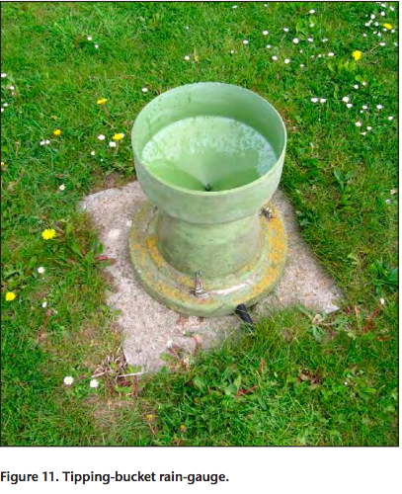
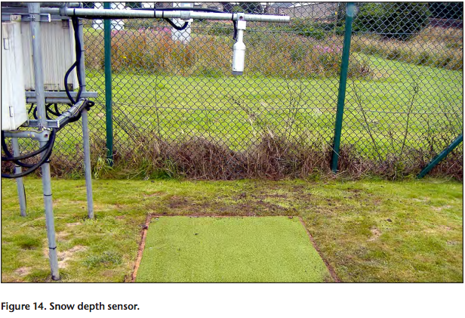
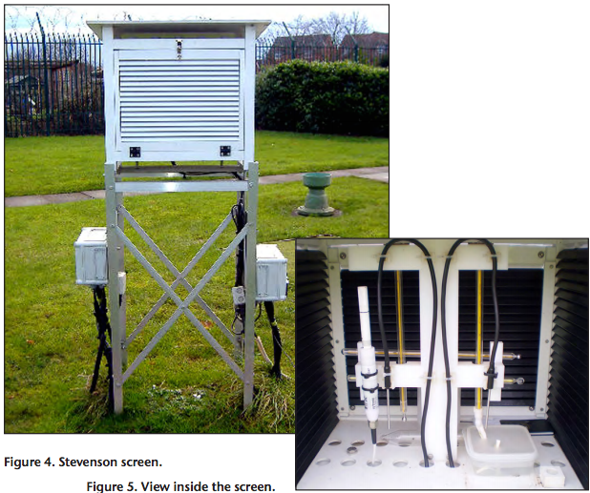
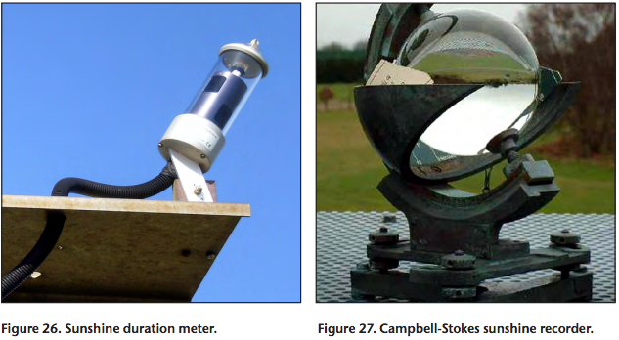
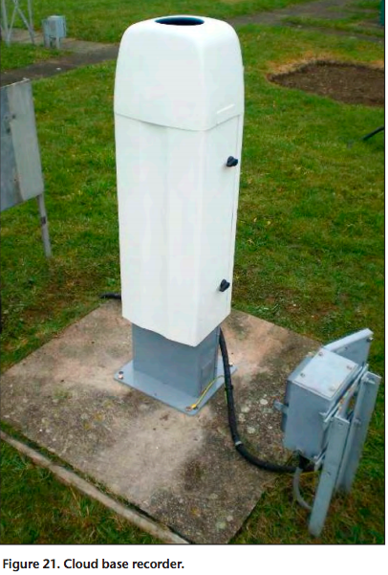
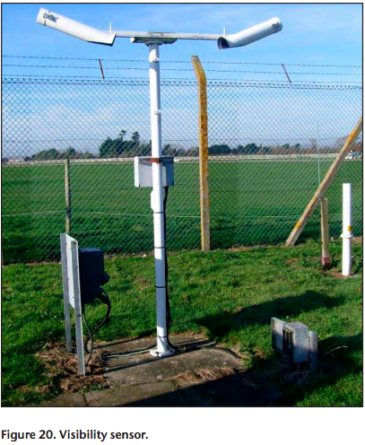
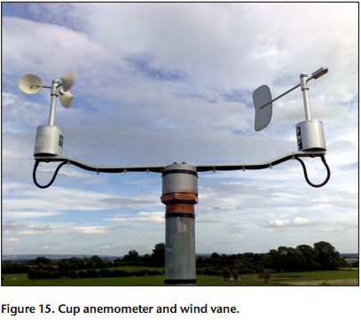
Match the measurement to the equipment.
Write down the factor which is to be measured underneath the equipment which aims to measure it.
Air temperature at 1.25 m above the ground
• Relative humidity at 1.25 m above the ground
• Amount of rainfall
• Depth of lying snow
• Mean wind speed, mean wind direction and maximum gust at 10m above the ground
• Atmospheric pressure at the station level and reduced to mean sea level
• Visibility
• Amount of cloud
• Height of cloud base
• Duration of sunshine
In your folders… For each measurement explain how it may be useful for predicting flooding.

