Slide 1

6GEO2 Unit 2 Geographical Investigations – Student Guide: Rebranding

Slide 2
CONTENTS
Overview
Requirements of the specification
What is rebranding?
Rebranding strategies
Ideas for fieldwork
Following up the fieldwork
Making it work for the exam
Click on the information icon to jump to that section.
Click on the home button to return to this contents page

Slide 3
1. Overview
Unit 2 has four components, but you are only required to study two of these.
In the 75 minute exam you answer one question based on your two chosen topic areas. This means there is no choice.
This exam is designed to test both knowledge and understanding of geographical concepts as well as geographical skills.
Fieldwork, research and the enquiry process lie at the heart of this exam.
The most important ways of ensuring the highest possible grades in this module is (i) being able to focus on the question set, (ii) to be able to use resources effectively, and (iii) to get your fieldwork in a form that works for the exam.
UNIT 2: The Paired Options –you only study one in each pair!
The ‘Physical’ Pair
Extreme Weather
Crowded Coasts
The ‘Human’ Pair
Unequal Spaces
Rebranding

Slide 4
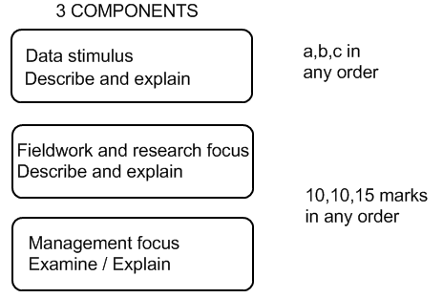
UNIT 2 – Assessment overview and structure
Normally the first part of each question starts with a data stimulus element.
The fieldwork and research elements are related directly to work you have carried out during a field trip AND may involve questions about how you processed, interpreted etc what you found.
The remaining question is more management and issues based. Here case study knowledge will be required.
The data stimulus in unlikely
to be the 15 mark question
Data stimulus with an analysis
element is possible

Slide 5
What is rebranding?
Its all about the brand – the image or symbol given sell or promote a to a product
Brand Artefact
Create a new environment
Reuse the existing environment
Remove old environment
Brand Essence
What its like to work there, live there, visit there. Who says what about it?
Brandscape
How does it compare with other places at a range of scales: local, regional, national and international?
Rebranding tries to improve a place and attract people and investment

Slide 6
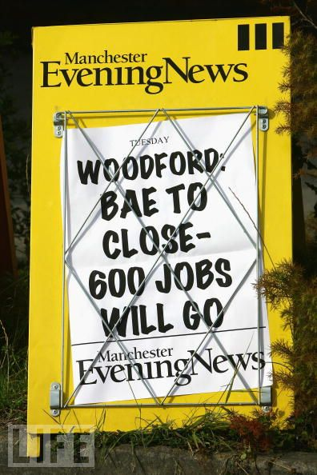
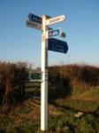
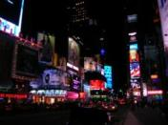
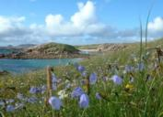
Why might places need rebranding?
There may be a number of linked reasons:
  The economy: loss of employment + dynamism
  The environment: problems with buildings + infrastructure?
  The image: inward investment + tourism?
Towns and cities | Countryside | Coastal areas
Depopulation? | Transport issues? | Inaccessibility?
Unemployment base? | Limited work? | Decline in tourism?
Desindustrialisation? | Agricultural change? | Loss of fishing?
Poor reputation? | Backward reputation? | No investment?
Each of these different areas face their own particular challenges, problems and reasons for decline

Slide 7
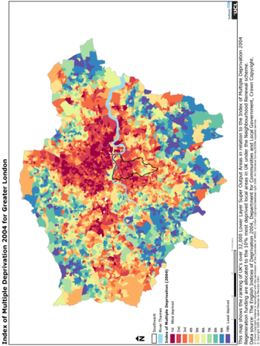
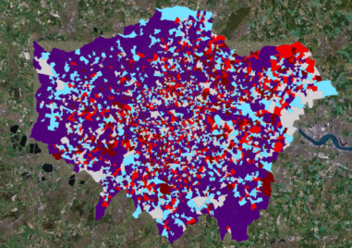
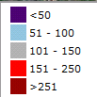
Deprivation?
A high deprivation score (or index) may mean that places need to rebrand. Health may also be linked to deprivation and the need to rebrand.
The IMD for London, 2004.
deprived wards concentrated north and east of the Thames,
the area of Docklands and around the new 2012 Olympics site. Other, smaller and more discrete areas often related to high levels of immigrant populations
An online GIS health map for London (http://www.londonprofiler.org/ ) This shows the distribution of lung cancer, where red colours indicate an higher incidence. There is a pattern, but it is more complex than the IMD above.

Slide 8
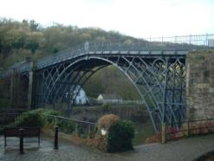
Winners and losers in leisure and tourism
Tourism is an important component of rebranding. Ironbridge, Shropshire has flourished through its links with industry, engineering and heritage
Changes in tourism and leisure have brought a series of winners and losers
Winners | Losers
Overseas destinations Near-motorway locations Self contained holiday villages ‘Eco’ and adventure destinations Cities (especially easily accessible) Night-time economy Affordable ‘branded’ hotels | Less accessible and peripheral locations Traditional seaside resorts (Victorian?) Mid + lower market guesthouses Non-specialist B&Bs Some lower profile visitor attractions
Which places and which types of location are more likely in need of rebranding?

Slide 9
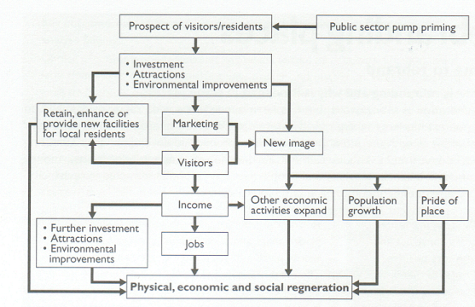
The strategies for rebranding
Rebranding may involve re-imaging, re-imagining, and redevelopment. Places need to refresh their identities, as well as attract new investment and encourage physical, economic and social renewal
Birmingham has created a brand based on a number of flagship buildings, as well as food.

Slide 10




Rebranding – the options
Rebranding usually has a number of aims:
Economic: to replace a ‘lost’ economic sector with a new one, creating employment and a positive multiplier.
Environmental: to improve the built environment, to the point that an area is able to project a new , attractive image as a place to be, rather than a place to avoid.
Social: to encourage population growth, and a more diverse population in terms of age, socio-economic group and possibly culture / ethnicity.
To achieve these aims, regeneration and reimaging are normally tied to a particular ‘brand’ which gives a strategy a focus and a public face. Logos’s have become a crucial part of this.

Slide 11

There are many different tools and ways to rebrand:
Heritage
Retail
Sport & Leisure
Media, arts & culture
Science
Green / sustainable

Slide 12
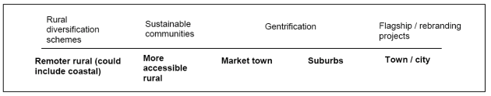
Rebranding players
Players
Regional Development Agencies
Local Councils
Business and
Industry
Local people and communities
Charities
European (EU) Money
Property developers
It is important to understand who is responsible for rebranding.
In the UK it does not ‘just happen’. There are always key players but these differ depending on the type and location of rebranding initiative. Rebranding may also operate along a ‘spectrum’:
Different players may initiate different types of scheme in different locations

Slide 13
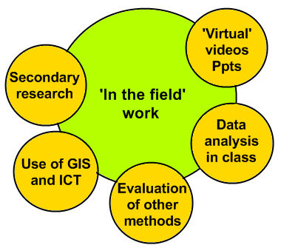
Thinking about fieldwork and research
Key fieldwork + research focuses
‘In the field’ can mean a variety of things. ‘Top-up’ from other sources if necessary to give coverage
Time to rebrand
Profile of places
Rebranding strategies
Rural strategies
Urban strategies
Managing rural rebranding
Assess success of schemes
Managing urban rebranding
Assess success of schemes
When preparing notes for revision don’t just list what you did. Add depth with places and examples of EQUIPMENT, NUMBER of surveys, details of LAND USE MAPS, even talk about SAMPLING.
The best answers often to refer to real fieldwork and real places

Slide 14
Examples of fieldwork and research
 | Time to Rebrand | Rebranding strategies | Managing rural rebranding | Managing urban rebranding
Example FIELDWORK | Fieldwork to uncover the ‘profile’ and identity of a location – reasons for loss of function and identity Range of possible options including various quality surveys (i.e. residential quality, shopping quality etc), ‘placecheck form’, photo and video evidence to exemplify problem areas; questionnaire to local residents and businesses; basic field notes and observations. Mixture of qualitative and quantitative approaches. | Questionnaires and extended interviews with key players / stakeholders locally to evaluate roles and opinions. Use of images (e.g. options a, b, c) – perception choices – what would you like? Delivered through on-the-street questionnaire. | Selection and establishment of criteria for success in RURAL rebranding. Visit location(s), collect qualitative and quantitative evidence, e.g. oral histories of change, perception of reputation, looking for evidence of change in functional hierarchy etc. Looking for evidence of improvements to ‘place image’, ‘product image and imaging rural people. Opportunity at busy rural rebranded locations to determine sphere of influence | Selection and establishment of criteria for success in URBAN rebranding. Visit location(s), collect evidence, e.g. photos of new design flagship architecture; proportion of retail occupancy; footfall; retail diversity (or quality of shopping); cloning, perception / reputation (through the analysis of various texts); More subjective evidence may include fieldwork which surveys the distribution of cranes in an urban spaces
Example RESEARCH | Census and other socio-demographic data to identify locations - Acorn and Cameo profiles of different postcodes (e.g. ‘checkmyfile’). In particular employment / socio-economic profiles; role of geodemographic data. | Research into the rebranding process, i.e. strategies to market and create identity: importance of environment, economy, socio-cultural identity. Researching the roles, identities and functions of various players through secondary sources and evidence. Local papers and arts groups may provide useful sources. | Research secondary evidence of success, e.g. photos illustrating change, changes in employment, visitor profile and published catchment survey data etc. | Research secondary evidence of success, e.g. crime statistics, visitor numbers / footfall patterns. Data from town / city centre management

Slide 15
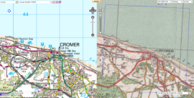
Fieldwork you can do before and during the site visit
Before you go out get the pre-research in order
Websites | Most rebranding schemes have a website and these often proclaim their success in terms of: Money spent Jobs created Construction Environmental improvements | Apply some healthy scepticism; data on job creation is notoriously difficult to quantify as jobs can move, so have not really been created.
Visitor surveys | Focus on where people have come from; this allows you to complete sphere of influence maps | A wider sphere of influence may suggest that a ‘brand’ is well known and new attractions are working
Questionnaires | Try and get local opinion, as well as that of visitors. It may be worth moving outside the area that has been rebranded in order to gauge the views of surrounding residents. | Careful questionnaire design is important; set yourself clear aims in terms of what you need to find out and decide on locations.
EQS | Very useful especially if you conduct them along a transect; compare regenerated and non-regenerated areas. | Comparing regenerated to un-regenerated is a good way of making a judgement
Landuse maps | These need to be detailed enough to analyse later i.e. building by building, and need to have a detailed key that can differentiate functions; small areas are better. | Aim to compare old landuse with new landuse – this way you can get a clear picture of what has changed.
Sites such as ‘Wheresthepath’ allow free GIS mapping with old and new OS maps side by side

Slide 16
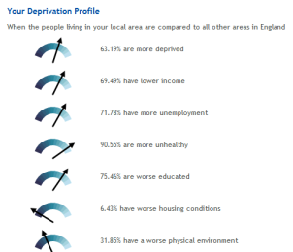
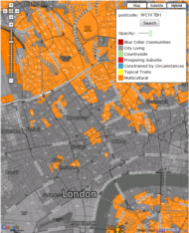
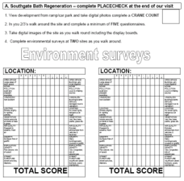
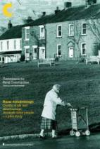
Opportunities for longer term research
Examine research sources such as the National Census accessed through neighbourhood statistics.
You can also use local authority websites for accessing a range of online GIS maps and data.
Within your school or college it is always useful to look back at data that was collected by students a few years ago. This is most likely available in an electronic form.
The Commission for Rural Inequalities has some interesting resource that could support rural rebranding

Slide 17
How would I measure other elements of rebranding?
Deindustrialisation | Newspapers – reporting factory closures and job losses; could be part of a questionnaire survey of changing economic circumstances / jobs.
Depopulation | Census at http://www.ons.gov.uk/census/index.html , which takes a snapshot of population every 10 years, so population change can be calculated.
Dereliction | Landuse surveys, identifying vacant buildings and unused / overgrown land; possibly part of an EQS especially if you used comparative areas.
Deprivation | Index of Multiple Deprivation; this can be found as part of the Census website but most local Councils have IMD data on their websites which is often easier to use.
You may have to find out about players also. More qualitative approaches required here.
Interviews | The ideal way would be to conduct an interview with representatives from the developers or the local council try to ‘dig’ for information on funding and partners.
Research | You should use the web to research who is involved often rebranding projects are intricate partnerships of private businesses, councils and government quangos.

Slide 18
Following-up the rebranding fieldwork?
A range of fieldwork follow-up options may be appropriate in order to better prepare for the exam. The most important activities are in the light green boxes | ACTIVITY 1 – METHODOLOGY WRITE-UP. Give a focus on the techniques and approaches used, how the sites were selected, justification etc. Remember to include both fieldwork and research ideas.
 | ACTIVITY 2 – PRESENTATION and ANALYSIS. Give a focus on the range of techniques used to present the data and say why you used them. Also include a description of how and why data was analysed (including qualitative, e.g. Annotation of photographs etc).
 | ACTIVITY 3 – RESULTS, CONCLUSIONS and EVALUATION. Give a focus on what you found, including some locational detail. You should also give details of selected results, and provide an evaluative framework, e.g. limitations, reliability of results etc.
 | Peer review of other modeled exam responses. Use highlighting, annotation etc to learn from other peoples work. This could be linked to a mark scheme,
 | A fieldwork glossary...very useful to help with technical language in the exam. This could be linked to a techniques matrix (see next slide).
 | A GIS / Google Earth map showing the locations visited as place marks.
 | Mock exam questions completed under timed conditions , linked to each of the three activities above.
 | A PowerPoint presentation , to focus on giving a ‘virtual tour’ of the locations / and or findings.

Slide 19
All linked to the success of rebranding
Matching your fieldwork and research to the question
Questionnaires | Include questions on the brand to assess how well known it is; consider showing people a range of logos and get them to identify the ‘correct’ one.
Activity counts | What are people doing? Have they ‘just come for a drink’ when the ‘idea’ was that they should be visiting an art gallery?
Local Press | Local newspapers rarely pull their punches if they think money has been badly spent – get into your local library and see what journalists are saying
Landuse surveys | Look for evidence of certain functions – sports, art, high end retail – are they present, or is the brand really just a ‘front’.
Be specific when answering a question – all these can be used to indicate ‘success’

Slide 20
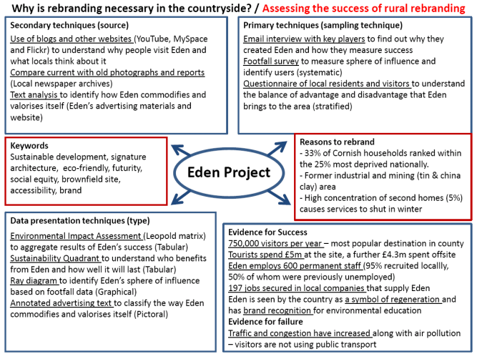
Get your summaries and case-studies together
Summary diagrams such as this can be very useful in preparation for the Unit 2 exam. There are ‘fact-rich’ and carry a range of ideas to help with both fieldwork and research as well as case study material
Source – Peter Symmonds College

Slide 21

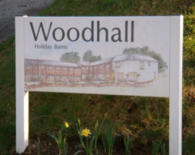
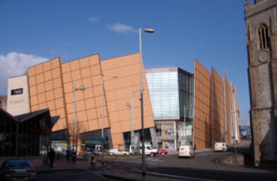
Success or failure – how can we assess?
Return to the aims of the rebranding. Very broadly these are likely to be some combination of:
Economic
Environmental.
Social
In terms of judging success you will need to use a mixture of fieldwork and research; quantitative and qualitative.

Slide 22
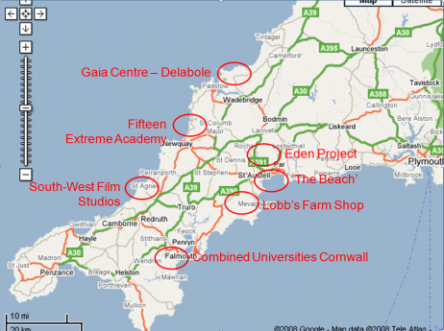

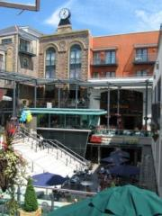




The Old Brewery Quarter, Cardiff
Rebranding in Cornwall
A rich mixture of private developments and public money, plus EU funding (e.g. Objective 1 match funding)
A private development: Countryside Properties plc, S A Brain & Co. , Mansford Holdings plc. Cardiff City Council and Cadw
The property developers then had the task of attracting tenants such as La Tasca, Starbucks and Chiquitos.

Slide 23
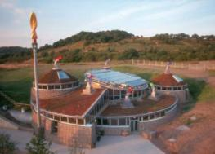
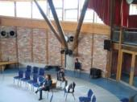
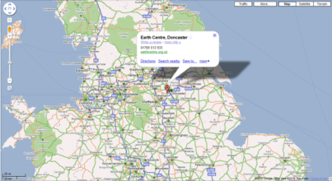
Rebranding doesn’t always work…..
Example: Doncaster’s
Earth Centre
Opened: 1999 Closed: 2004
Location: close to Doncaster built on 400-acre site of a former colliery
What? A leisure, recreation and education park designed to showcase sustainable living
Cost: about £60 million, funded largely by the Millennium Lottery Commission.
Closure? Lack of visitors; the centre‘s location was not great and transport access was poor and there was limited interest in the overall idea
The site is now used as a paintballing / airsoft skirmishing site.

Slide 24
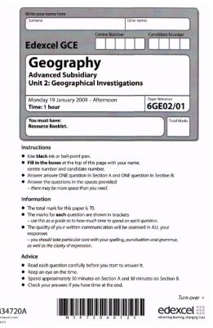
Summary
Revise your personal fieldwork and research on rebranded urban and rural areas thoroughly.
Know details on sampling, surveys, presentation, analysis and conclusions.
Know the location(s) and why it needed rebranding.
What were the aims of rebranding?
What the ‘brand image’ is and how it might have changed over time.
Be clear about ways to judge its success.

